Slide 1



VideoClub SQL Database
Iñigo Larrea DAFT Oct2022

Slide 2
Index
Summary
3
Dataframes Clean up
5
Dataframes Load
12
SQL fk Relations
15
SQL Queries
17

Slide 3
Summary
3
1 - Load and clean *.CSV (Pandas Dataframes)
2 – Upload Dataframes to SQL
3 - Create SQL fk relations
4 - Launch SQL queries

Slide 4

Dataframes Clean up

Slide 5
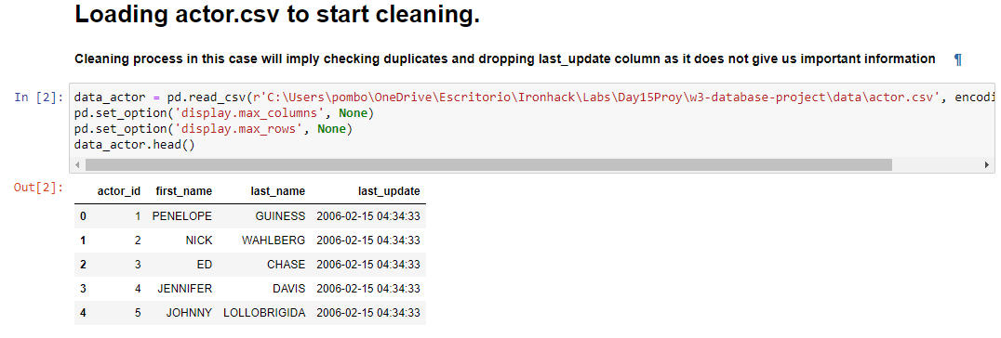
DataFrames Clean up

Slide 6
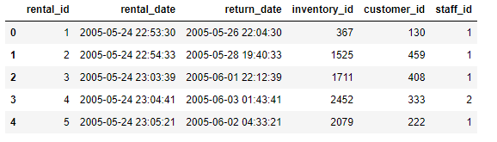

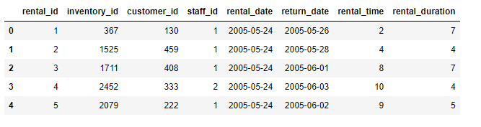
DataFrames Clean up
PROCESS IN THE FOLLOWING SLIDES

Slide 7
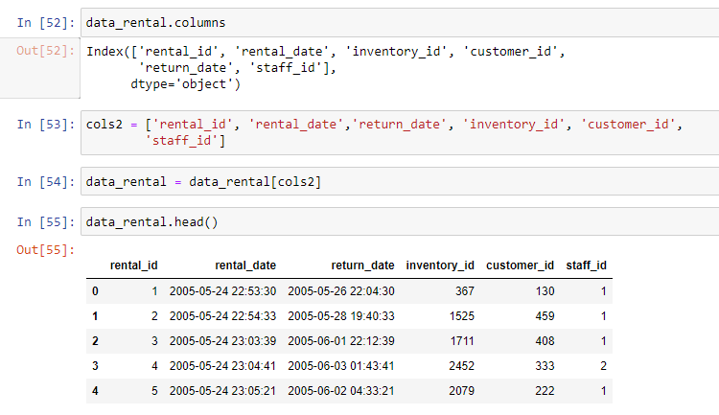
DataFrames Clean up
Reorder columns

Slide 8
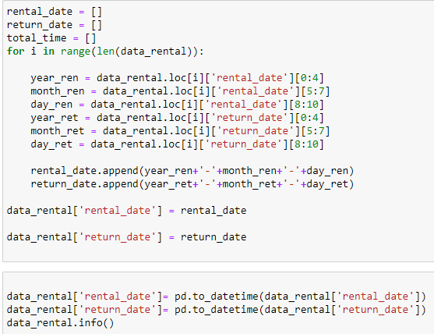
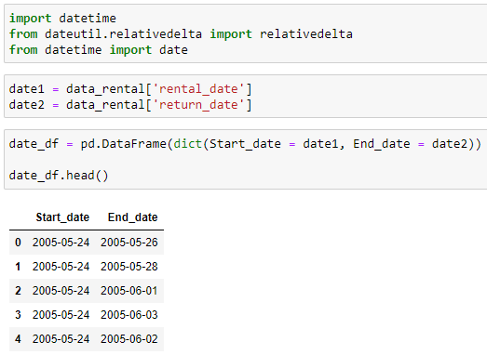
DataFrames Clean up
Clean Dates so they are manageable

Slide 9
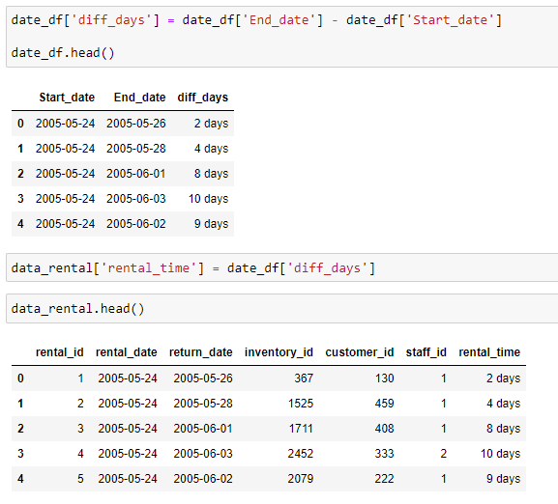
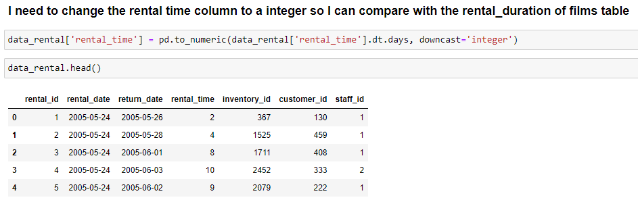
DataFrames Clean up
Difference in between rental and return date in datetime format
Pass Rental_time to integer so we can use operators easy.

Slide 10
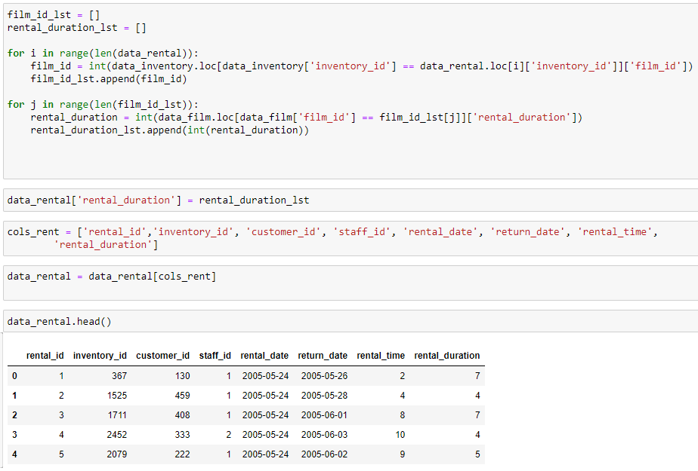
DataFrames Clean up
Last was to create a relation in between dataframes do I could extract Rental_duration from film Df and insert it in the rental Df so it was easier to relate in SQL

Slide 11

Dataframes Load

Slide 12
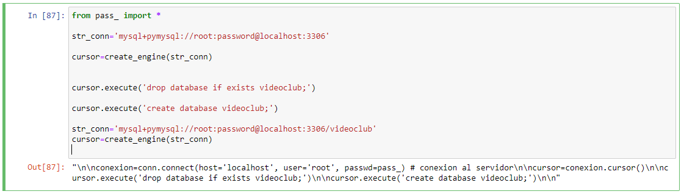
DataFrames Load

Slide 13
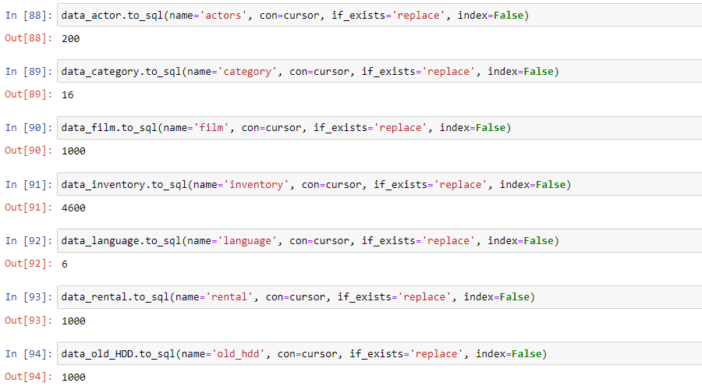
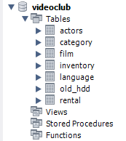

DataFrames Load

Slide 14
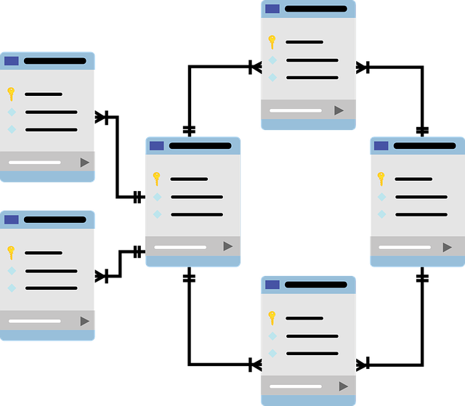
SQL fk Relations

Slide 15
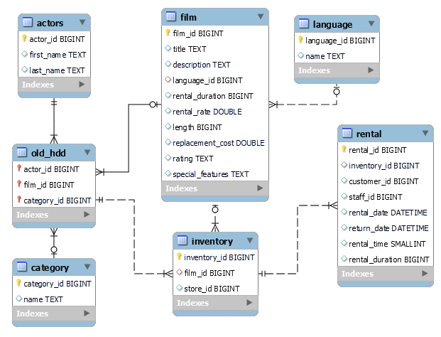
SQL fk Relations

Slide 16

SQL Queries

Slide 17
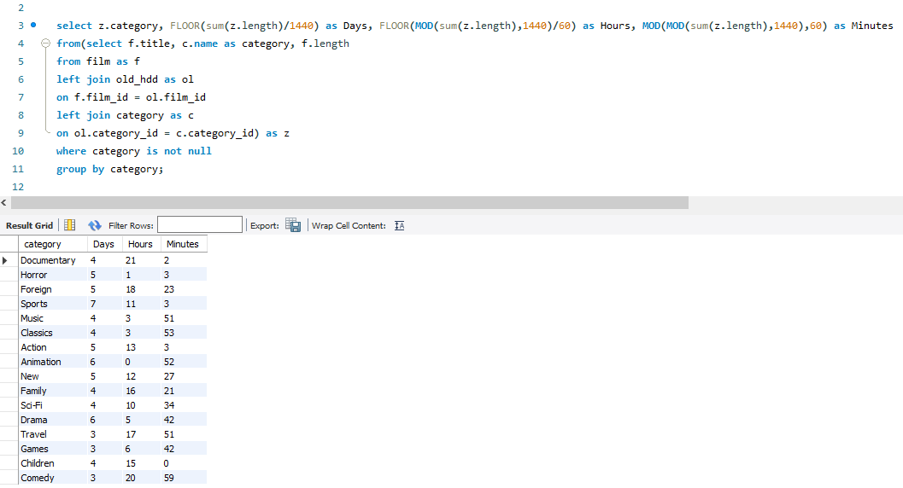
SQL QUERIES
Time in days, hours and minutes of each category in the film catalogue.

Slide 18
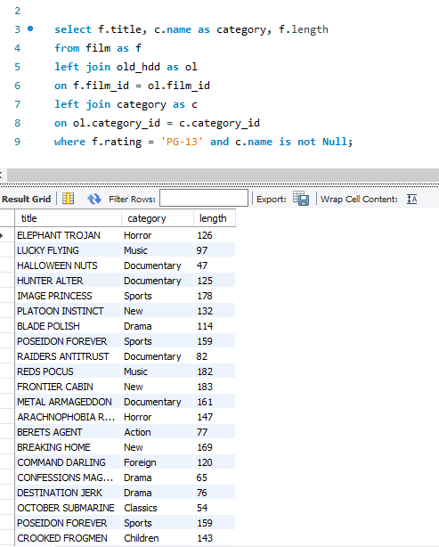
SQL QUERIES
Title, category and length of every film in the film catalogue that is from PG-13 rating.

Slide 19
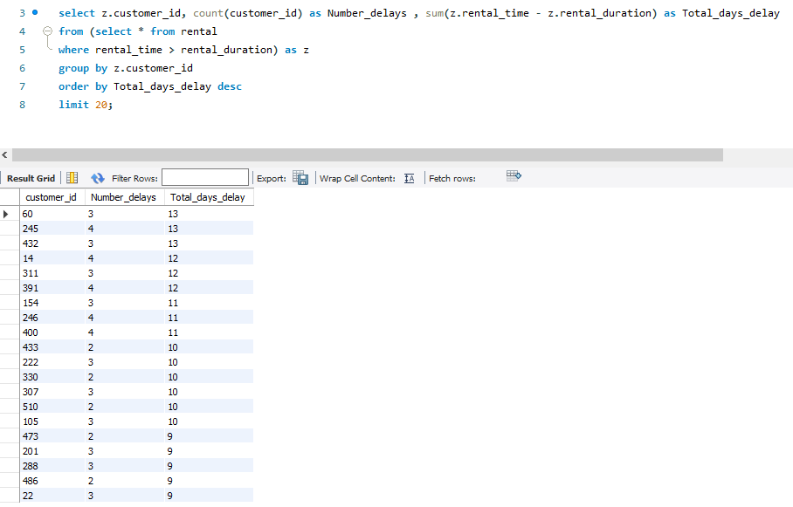
SQL QUERIES
Customer_id with number of times they delayed the return of the rental and the total days of delay. Ordered by total days of delay and limited to top 20

Slide 20
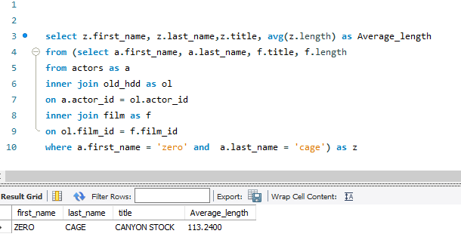
SQL QUERIES
Average length of the films that Zero Cage has acted in…

Slide 21
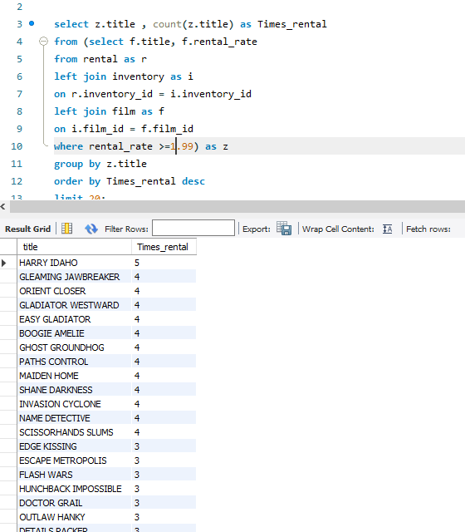
SQL QUERIES
Number of times a film with rental_rate >= 1.99 has been rented order descending to find top20 movies.

Slide 22



Thank you ☺
www.linkedin.com/in/inigo-larrea-pombo
Iñigo Larrea
+34 636566795
pombo7676@gmail.com
www.linkedin.com/in/inigo-larrea-pombo

